Slide 1




HCCB Disrupt Season 1
#ThirstForInnovation
Team SORTED
Devesh Sinha Mohit Kiradoo Kajal Gupta
T. A. Pai Management Institute

Slide 2
RECAP – ROUND 1 SUBMISSION
Problem overview
Problems in logistics of HCBL
HCBL is facing problems in the transportation due to inflation in oil prices and high carbon emissions, as their logistics movement is primarily driven by diesel trucks.
A thorough analysis of the present situation and feasible solutions to meet the short term and long-term objectives of the company is required.
Dominated by diesel driven trucks
High volatility in fuel prices
Rising transportation cost
High carbon emissions
Current Situation Analysis
Transportation Movements | Fuel Consumption per trip(l) | Fuel Cost incurred per trip(₹) | Total freight cost(₹) | Carbon Emission per trip(kg)
Intra unit | 1467 | 1,32,000 | 3,77,143 | 3,960
Inter unit | 85260 | 76,73,400 | 1,70,52,000 | 2,30,202
Customer movement | 133424 | 1,20,08,160 | 2,66,84,800 | 3,60,245
3.68 cr litres
₹331 cr
39626 T
Annual diesel consumption
Approx Cost incurred in fuel consumption
Annual approx. carbon emission
Assessment of feasibility of alternative fuels
Recommendations Suggested
Expected Impact in 5 years
Availability
1
Phased switching to EV for customer movement for vehicles >8 yr old
52%
reduction in carbon emissions from current scenario (EV)
Cost
2
E20 blend with diesel
Emissions
22%
increase in carbon emissions from current scenario (E20 blend)
3
Exploring the scope of Carry & Forward (C&F) Agent
Vehicle Compatibility

Slide 3

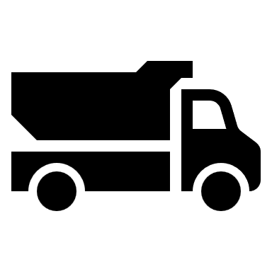
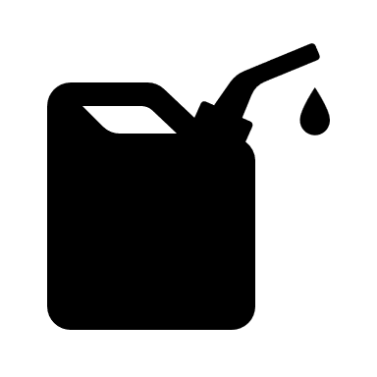
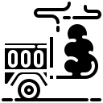



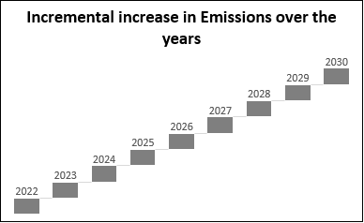
Analyzing the current scenarios and suggesting implementations for Intra Unit Movement
Current Situation
Road
Current mode of transport
255
Dedicated units used
1700
Litres of fuel consumption per day
4590
Kg CO₂ Emissions per trip
4.7x
Increase in Freight cost
4.3x
Increase in CO₂ emission
Recommendation
Plan of action
Modify contract agreements to upgrade vehicles to BS6 norms
Explore the scope of C&F agents or collaboration with agents doing similar line of business
Cost: Contract price increase by 10-15%
Benefits:
Low cost incurred due to no ownership
Faster Implementation
25% lower emissions
Incentivize contractors to update the fleet
Incentives in form of long term contracts, monetary rewards
Phased incentivized EV implementation for contractors, on availability of vehicle as per specifications required
Expected outcome
Estimated 25% reduction in CO₂ emissions
40% reduction in emissions by 2028 on EV implementation
Note: Shifting to EV will entail high cost, hence is not feasible in this type of movement. Moreover the payload capacity and the efficiency of EV is low

Slide 4
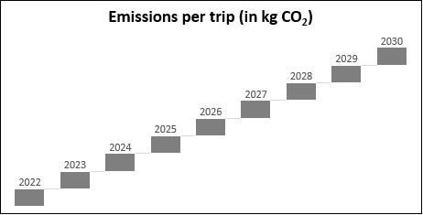
Analyzing the current scenarios and suggesting implementations for Inter Unit Movement
Current Situation
Road
Current mode of transport
485
Dedicated units used
95060
Litres of fuel consumption per day
256662
Kg CO₂ Emissions per trip
6.7x
Increase in Freight cost
4.3x
Increase in CO₂ emission
Recommendation
Plan of action
Implementing Intermodal transport
Optimize market truck units for freight movement
Use of multi-mode transport to cater to markets
Reduce cost per km per tonne incurred in logistics
Utilizing the intensive rail network to penetrate to locations with poor road connectivity
Eastern Dedicated Freight Corridor: Dankuni(WB) – Khurja(UP)-Ludhiana(Punjab) (1839km)
Western Dedicated Freight Corridor: Dadri(UP)- Ajmer(Rajasthan) – Surat(Gujarat) – JNPT(Navi Mumbai)
Existing Railway Network for transporting cargo
Highly efficient locomotives (eg: WAG 12B)
Average cost per km per tonne through road = 18
Average cost per km per tonne through water = 15
Average cost per km per tonne through rail= 11
In states like Maharashra, where the road connectivity is superb, the preferred mode of movement should be road(cost drops to 12-13 per tonne per km), while Northern states do not have HCCB clusters, hence, the railway network and the National waterways can be used to cater. Hence, an intermodal transport network needs to be implemented to check on emissions as well as cost.
Plan of action
Use National Waterways to cater to markets where there is low road or rail connectivity
NW1(Allahabad - Patna – Farakka – Haldia)
NW2(Sadiya – Dhubri)
NW3(Kollam – Kottapuram)
NW4(Kakinada to Pondicherry)
NW5(Talcher – Paradeep)
NW6( Lakhipur - Bhanga)

Slide 5


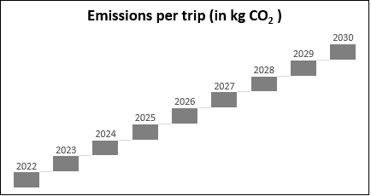
Analyzing the current scenarios and suggesting implementations for Customer Movement
Current Situation
Road
Current mode of transport
1760
Dedicated units used
103645
Litres of fuel consumption per day
279840
Kg CO₂ Emissions per trip
6.5x
Increase in Freight cost
4.3x
Increase in CO₂ emission
Recommendations
Plan of action
Plan of action
Ethanol blended fuel for lower emissions
Intermodal Transport to reduce cost and emissions
Carry & Forward Agents from 5500+ distributors
Phased introduction of EVs on availability
Intermodal Transport to cater to customers:
Choose 500 C&F Agents from 5000+ distributors based on specified selection criteria: history, reach, and financial strength
Benefits: Lower number of units required, lower cost incurred in distribution
Phased introduction of EV for catering to NKA movement, as desired specifications are available. Currently, vehicles with payload upto 1 T are available (Tata Ace EV)
Benefits: Clean and sustainable transport to NKA
Roadways
Railways
Plan of action
Waterways
Ethanol blended fuel to reduce carbon emissions
Currently, E5 and E10 blends are available, E20 to be available from April 2023
Benefits:
10% reduction in fuel cost
Upto 30% reduction in emissions
Assess the mode of transport to be used for each location based on the following:
Connectivity through each mode
Cost of servicing
Emissions in transport

Slide 6
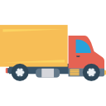

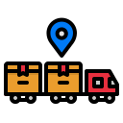
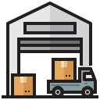


Summarizing the 3 types of movement for catering to the customers
C&F Agent
Intra Movement
Inter Movement
Customer Movement
Goal Setting
Implementation timeline
10% of the total transport to be done through Railways by 2025
5% of the total transport to be done through National Waterways
Phased introduction of EV to cater to NKA movement. 25% of the fleet to be electrified by 2030
Exploring the scope of the C&F agent model of distribution to outsource operations requiring last mile delivery
Optimization of network design to allocate warehouses or resources at locations reducing cost
Expected Outcomes
On successful implementation of the goals, 25% reductions in emissions are observed from 2027 and by 2030, emissions are expected to be reduced by 45%.
Click here for Annexures

